Slide 1
Customer Activity Tracking Within Retail Stores
Adham Nagaty, Nour el Samaa Khalaf, Nadder Ragi

Slide 2
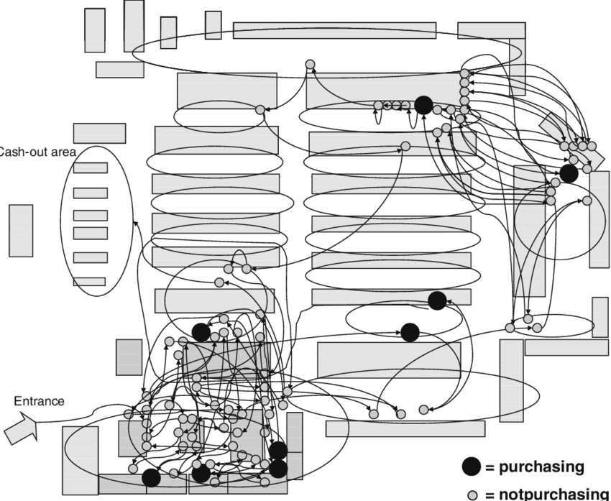
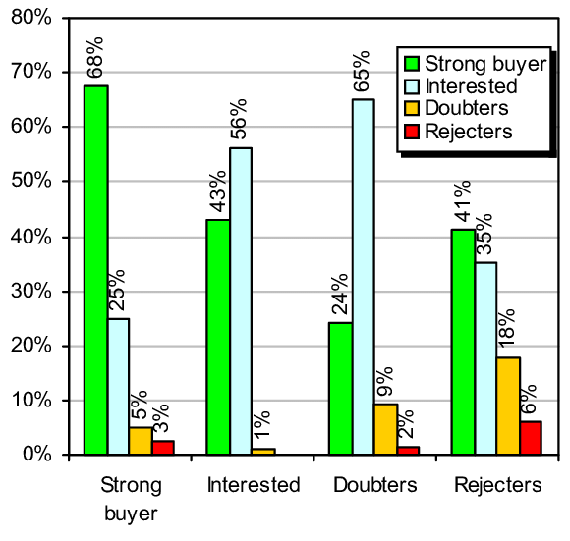
Introduction 1 - Domain Introduction
Purchasing vs Non-Purchasing Customer Movement Within a Supermarket
Customer interaction with retail store products is poorly understood VAGUE
Time spent mindlessly wandering, searching for products, and observing products is time that can be used for more efficient marketing
Computer vision and movement tracking can tap into this analytics gold mine
Statistics Inferred After Analysis of Customer Movement

Slide 3
Introduction 2/2 - CS Challenges
Videos of poor quality can be difficult to process
Crowds can cause occlusion of customers
Deep learning models can be difficult to implement on antiquated camera systems
Model will face difficulty determining cause of product return.
Track customers across cameras

Slide 4
RW 1- Customer Analysis via Video Analytics: Customer Detection with Multiple Cues
MOTIVATION: Extracting valuable information from customer analytics to aid in targeted marketing
PROBLEM: Analysing frames from multiple cameras causes confusing interpretation of code
HYPOTHESIS: Customer behavior using video analytics will lead to better marketing decisions.
EXPERIMENT: Video analytics using G, T, and GT, and HOG-based radial-basis SVM classifiers.
CONCLUSION: Analysis was successful in analysing customer trajectory and frequently visited locations, although the models needed improvement.
http://acta.uni-obuda.hu/Katanyukul_Ponsawat_74.pdf

Slide 5
RW 2 - Intelligent Processing of Video Streams for Visual Customer Behavior Analysis
MOTIVATION: Tracking customer behavior in physical stores to better adjust marketing strategies
PROBLEM: Conventional CCTV image resolutions are poor, leading to difficulties in object detection
HYPOTHESIS: Tracking and analyzing customer movements in a retail environment using aerial-mounted cameras and computer vision algorithms can provide insights into customer behavior and help optimize the shopping environment for better customer engagement.
EXPERIMENT: Using aerial-mounted cameras and object detection computer models (DBScan, Markov Chains)
CONCLUSION: Object tracking in retail store CCTV cameras proved effective for optimizing marketing strategies
http://personales.upv.es/thinkmind/dl/conferences/icons/icons_2012/icons_2012_8_20_20040.pdf

Slide 6
Scientific Process 1/3
Problem Statement
The challenge faced by physical hypermarkets is in need to implement a computer vision-based customer/product tracking system to enhance marketing strategies and customer interactions.
Hypothesis
Implementing a computer vision-based customer tracking system in physical hypermarkets will lead to enhanced marketing strategies and customer interactions, ultimately resulting in increased customer retention and attraction.

Slide 7
Scientific Process 2/3
Experiment
The use of cameras, sensors, object detection computer models and learning model for customer behavior vis-a-vis products on shelves.
Conclusion
The imperative for physical hypermarkets lies in the implementation of a computer vision-based customer and product tracking system to not only elevate marketing strategies and customer interactions but also to remain competitive and responsive in the ever-evolving retail landscape.

Slide 8
System Overview
Presented physically

Slide 9
Demo
Classify a circle drawn by my palm , Thumb , https://depts.washington.edu/acelab/proj/dollar/index.html
https://pypi.org/project/dollarpy/

